Slide 1
WasteZero® Trash Bag Fundraising Program
2018

Slide 2
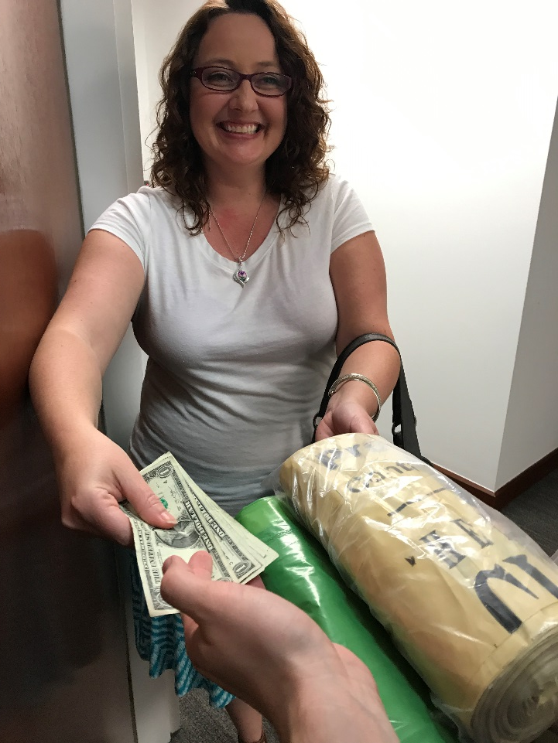
Today’s Topics
1
About WasteZero®
Why This Program Works for Scouts
Customers Love the Product
Complete Sales Support
Pricing & Profits
2
3
4
5

Slide 3

About WasteZero®
1
Founded in 1991, WasteZero® is on a mission to cut the trash in half across the US.
WasteZero is a certified B Corp, meeting rigorous social and environmental standards.
We are the national leader in helping cities and towns reduce waste and save money through innovative waste reduction programs.
To support our programs, we
  Maintain a plastic bag manufacturing plant in Hemingway, SC, which uses recycled materials to make plastic bags for a range of specialized uses
  Part of our work involves helping nonprofit organizations use trash and recycling bags for fundraising.
Notes:
STORY:
Here’s a little bit about us, our focus, and our commitment.

Slide 4

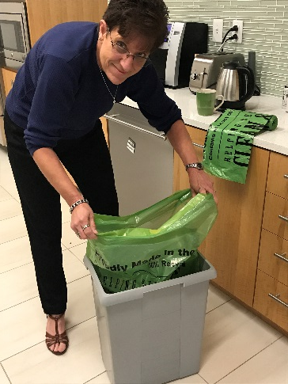
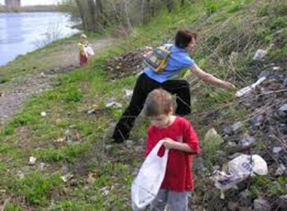
Why Trash Bags Work for Fundraising
2
1. Product Everyone Needs
A product that everyone needs and uses daily
Great for large orders, repeat orders, & friends & family sales
Supporters can purchase in quantity for their businesses
2. Eco-friendly Product
Made in the USA from at least 50% recycled content
Offered with minimal packaging
3. Keep America Clean
& Green
Aligned with Scouting principles of keeping America clean & green, leaving the world better & cleaner

Slide 5

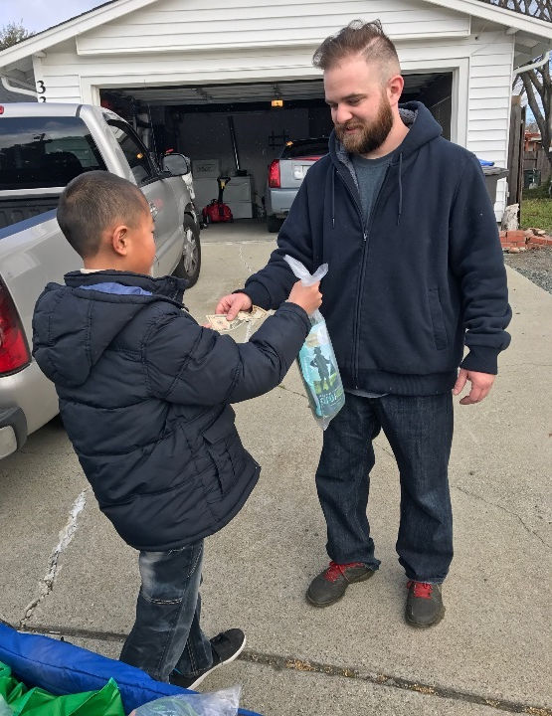
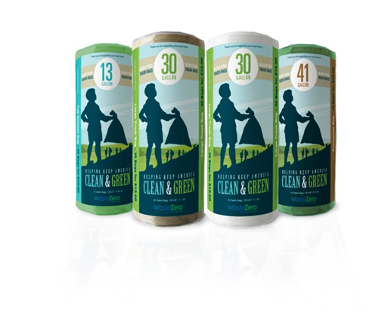
Customers Love the Product
Made in the USA with Recycled Content
Affordably priced and closer to standard retail than many fundraising products
Convenient drawstring closure in most popular sizes
Linear Low-Density Polyethylene (LLDPE) with strong 3-ply construction
Package: Roll in clear plastic sleeve with printed insert

Slide 6




Complete Sales Support Every Step of the Way
Selling Kit
4
2017 Trash Bag Fundraising Program
Sales Tracker
Selling Tip Sheets
Preparing & Motivating Your Sales Team
Selling Strategies
“Show & Sell” Events
Personal Selling
Business Sales
Sales Banner
Parking Lot / Yard Signs
Order Forms
“Not at Home” Flyer
Sales Guide for Selling to Businesses
All of these materials will be delivered to your Bagadier General™
to make selling efforts a resounding success!

Slide 7
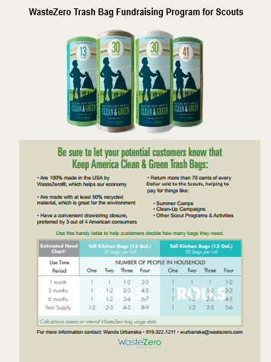
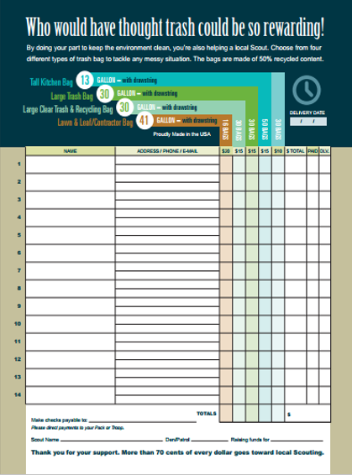
Complete Sales Support Every Step of the Way
Brochure and Order Forms
4

Slide 8
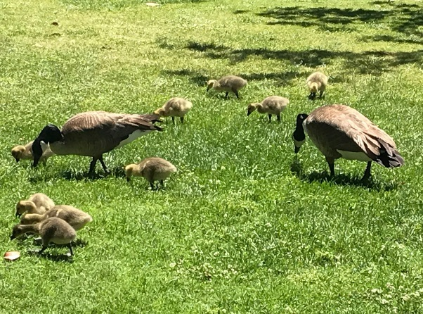
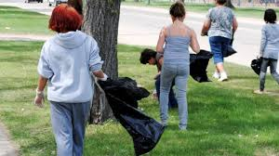
Pricing and Profits
Product Specifications List
5
Type | Capacity (gal.) | Dimensions & Closure (in., WxH) | Gauge (mil) | Color | Bags per roll | Rolls per case | Your price/ roll | Retail price/ roll | Your profit/roll | Price per case
Tall Kitchen Bag #3788 | 13 | 24x27 Drawstring | 0.95 | Olive green | 30 count | 20 rolls | $2.95 | $10.00 | $7.05 | $59.00
Tall Kitchen Bag #3413 | 13 | 24x27 Drawstring | 0.95 | Olive green | 50 count | 16 rolls | $4.50 | $15.00 | $10.50 | $72.00
Large Trash Bag #3414 | 30 | 30x35 Drawstring | 1.1 | Tan | 30 count | 14 rolls | $4.40 | $15.00 | $10.60 | $61.60
Each trash bag product will achieve the target contribution margin of 70%,
making it the perfect supplement for popcorn sales.

Slide 9





Next Steps
WasteZero® can help you explore multiple methods for selling product, including alternatives that minimize “door-to-door” selling by Scouts, if needed.
Traditional Methods
Potential Alternatives
Door-to-Door
“Show & Sell”
E-Mail
Direct Mail
Telemarketing
Collect your feedback and answer your questions.
Determine level of interest.
Determine if the Council would consider piloting any of the selling method above with units.
If so, WasteZero will develop a proposal.

Slide 10

Thank You!
On her TV series, Simple Living with Wanda Urbanska, she defines simple living as anchored by four principles:
Environmental stewardship
Thoughtful consumption
Community involvement
Financial responsibility
For More Information, Contact:
Dennis Wise
dwise@wastezero.com
Office: 919.322.1228
Cell: 919.796.9221
The WasteZero® trash bag fundraising program offers scouts a chance to combine
all of these ideals into one terrific fundraising program.

